Slide 1
STAT 504 – Network and Text Analytics Lecture 12: Phrase Mining
By Dr. Ellie Small

Slide 2
Overview
Topics:
Review
Phrase Mining
Double Counting
Principal Phrases Example
Phrase Mining in R
Phrase Mining in R: Example
Problem

Slide 3
Review
Highlights of Lecture 11
We can create a term frequency for a single document using the function termFreq on a PlainTextDocument resulting in an integer vector called a term_frequency, containing the frequencies of the terms present in the document with the terms as its names.
The stemDocument function takes a PlainTextDocument as input and outputs a PlainTextDocument with all its words changed to their stems.
R contains several sentiment lexicons among which the bing lexicon, accessed via get_sentiments("bing") or via the data frame sentiments in the tidytext package. It assigns a positive or negative sentiment to each word, but a few words have both. The afinn lexicon, accessed via get_sentiments(“afinn“), assigns an integer between minus five (negative) and plus five (positive). The nrc lexicon, accessed via get_sentiments("nrc"), assigns emotions indicated by their names to words. Note that it can assign multiple emotions to the same word.
The package dplyr contains several types of joins, the most important for our purposes is the inner join, performed by the inner_join function. This takes two data frames, x and y, as its arguments and attempts to match the two data frames using any column name the two data frames have in common. It returns a data frame with a subset of the rows in x, returning only those rows for which there was a match with y. The columns returned are the combined columns of x and y. It can be used to assign sentiments to the words in a term frequency vector or a term document matrix.
A word cloud is a visualization of a set of terms with its frequencies, where the size of the term is based on its frequency, and where different frequencies have different colors. Word clouds in R are available in two packages: wordcloud, and wordcloud2 with identical names for the functions, the former taking a vector of terms and a vector of frequencies as its arguments, the latter taking a data frame with the columns word and freq as its argument.
Homework 11 Review

Slide 4
Phrase Mining
So far, we have selected words from either documents or corpora. However, instead of words, we may want to select phrases instead.
Obtaining phrases comes with unique challenges not present when obtaining words.
We could select so called n-grams; an n-gram is any combination of n words that exists in a text. However, not all n-grams will be meaningful, and we would like to exclude any n-grams that are not meaningful.
Note that we cannot remove stop words. Otherwise a phrase like “cats and dogs” would turn into the meaningless phrase “cats dogs”. But if we included stop words, we would obtain meaningless phrases such as “and this disease”, and “attack of”. So we want to only select phrases that do NOT start or end with stop words. However, stop words in the middle are okay. In addition, phrases starting with the stop words “no” or “not” should not be excluded.
Some n-grams are inherently meaningless, such as “here we are”, and we would like to exclude those altogether.
Selecting n-grams that cross punctuation marks generally also results in meaningless phrases. So we must make sure not to do that.

Slide 5
Double Counting
Double counting occurs when the frequency of a word or group of words is counted in multiple phrases, resulting in meaningless subsets of phrases being presented as frequent phrases together with their meaningful super phrases since they would occur with the same frequency.
As an example, consider the phrase “support vector machine”, with its sub phrase “vector machine”. The first is meaningful, the second is not, as it would never occur on its own; it would only ever occur as a part of the phrase “support vector machine”. If we were to count the frequencies of all n-grams, however, both would occur with the same frequency.
In addition, meaningful, but generally less common phrases such as “support vector” would have their frequency exaggerated since the frequencies of “support vector machine” would be added to its stand-alone occurrences. This would cause any sub phrase such as “support vector” to always appear to be more frequent than its super phrase.
Because of these issues, we need to restrict ourselves to meaningful phrases that are frequent by themselves only. We refer to such frequent and meaningful phrases as principal phrases.
We obtain principal phrases with a rectification process that starts with n-grams. It then selects the most frequent n-grams with the highest n first, designates those as principal phrases and reduces the frequency of any n-gram that starts or ends inside one of the occurrences of those principal phrases. The end result of this rectification process is that all double counting is removed.

Slide 6
Principal Phrases Example
Let’s consider the sentence “The authors wrote abstract phrase mining papers” as part of a larger text. The question is, what are the principal phrases in this sentence?
First, let’s find all the n-grams. Since we will not have our n-grams cross punctuation marks, n is at most 7. However, “the” is a stop word, and thus no n-gram can start with it. As such the largest n-gram has n=6, and the 6-gram is “authors wrote abstract phrase mining papers”. We have the following n-grams in the sentence:
2-grams | authors wrote wrote abstract abstract phrase phrase mining mining papers
3-grams | authors wrote abstract wrote abstract phrase abstract phrase mining phrase mining papers
4-grams | authors wrote abstract phrase wrote abstract phrase mining abstract phrase mining papers
5-grams | authors wrote abstract phrase mining wrote abstract phrase mining papers
6-grams | authors wrote abstract phrase mining papers
Each of these n-grams will be assigned frequency 1 due to our sentence.
We see that this one short sentence gives rise to 15 n-grams, some of which do not appear to be meaningful phrases.
Which ones will be selected as principal phrases depends on the occurrence of the same n-grams in other parts of the text.

Slide 7
Principal Phrases Example - 2
Let’s assume that the minimum frequency for principal phrases is 3, and that the only n-grams that made the frequency requirement in the sentence “The authors wrote abstract phrase mining papers” are the following:
n-grams | frequency
abstract phrase | 10
phrase mining | 18
mining papers | 5
authors wrote abstract | 3
abstract phrase mining | 10
phrase mining papers | 5
The largest n here is 3, so we look for the 3-gram with the highest frequency. That is the phrase “abstract phrase mining”. We designate this as a principal phrase.
Then we look for any n-grams whose words started or ended in one of the occurrences of this phrase.
The n-gram “abstract phrase” occurs in each, so its frequency is reduced by 10. This causes it to be eliminated; it is NOT a principal phrase.
The n-gram “phrase mining” also wholly occurs in “abstract phrase mining”, so this n-gram also loses 10 frequencies. In this case, however, 8 more frequencies are left.
In our sentence, “mining papers” starts in our principal phrase, so it would lose one frequency for that occurrence. There may be additional such occurrences, let’s say there are 3 of those. So “mining papers” ends up with a frequency below 3 and would be eliminated.
Similarly, “authors wrote abstract” ended inside the principal phrase “abstract phrase mining” for our sentence. As such it loses at least one frequency and is eliminated.
Finally “phrase mining papers” also starts in our principal phrase in our sentence, so that one also loses at least one frequency. If there are more such cases, it may also end up below 3 and be eliminated.
In the end, all that is left besides “abstract phrase mining”, is “phrase mining” with a frequency of 8. If its frequencies stay above 3 when all other principal phrases consisting of 3 words have been processed, it will also be designated as a principal phrase.
Note that the only two n-grams left from our sentence are meaningful ones. Also note that “phrase mining” ended up with a lower frequency than its super phrase “abstract phrase mining”.

Slide 8
Phrase Mining in R
The R package phm provides a function called phraseDoc, which selects principal phrases only from a document or corpus. It does this by breaking each text into blocks separated by punctuation, selecting n-grams with their frequencies only from within those blocks. Then it does the following (amongst some other things):
Remove all phrases that start or end with stop words.
Remove a set of user-supplied phrases that the user considers not meaningful.
Remove all double counting; if a phrase is already present inside another frequent phrase, its frequency will be reduced appropriately. It does this via a rectification process.
The function takes as input either a character vector with each element the text of a document, or a VCorpus object. There are several arguments that will control the phrases to be returned; check out ?phraseDoc for those arguments.
It outputs an object of type phraseDoc, which, like the TermDocumentMatrix, is a more efficient way to store principal phrases by the document they appear in. As before, we can create a term-document matrix using the function as.matrix, this time on the phraseDoc object. However, in this case the terms are principal phrases rather than words. The names of the columns equal the column indices, rather than their IDs as it is for the term-document matrix on words.
We may deal with the term document matrix the same way as before; we can obtain information about certain phrases, perform operations on them, and create word clouds.
The phm package provides 3 additional functions: freqPhrases, getDocs, and removePhrases. The function freqPhrases takes a phraseDoc object and a number n as input (default 10) and shows the n most frequent phrases in the corpus. The function getDocs takes a phraseDoc object and a character vector with principal phrases as input and returns a matrix with those principal phrases (if they exist) on the rows and the documents they appear in on the columns. The function removePhrases takes a phraseDoc object and a character vector with principal phrases as input and returns the same phraseDoc object with those principal phrases removed.

Slide 9
Phrase Mining in R: Example
Install and attach the package phm:
install.packages(“phm”)
library(phm)
Read the March 1 Covid-19 PubMed data into a corpus:
co=VCorpus(PubMedSource(toDataFrame("../tmData/Covid19March1.txt")))
Create the term-document matrix, where the terms are principal phrases:
pd=phraseDoc(co)
pdm=as.matrix(pd)
Obtain the 6 most frequent principal phrases in the corpus:
freqPhrases(pd,6)
Check the frequent principal phrases in document 8:
pdm[pdm[,8]!=0,8,drop=F]
novel coronavirus february 2020
28 17
confirmed cases diagnosis and treatment
17 15
coronavirus disease 2019 hubei province
15 14
docs
phrases 8
control measures 1
covid-19 epidemic 1
known as 2019-ncov 1
monitoring of bilirubin level 2
outbreak of coronavirus disease 2019 1
prevention and control 1

Slide 10
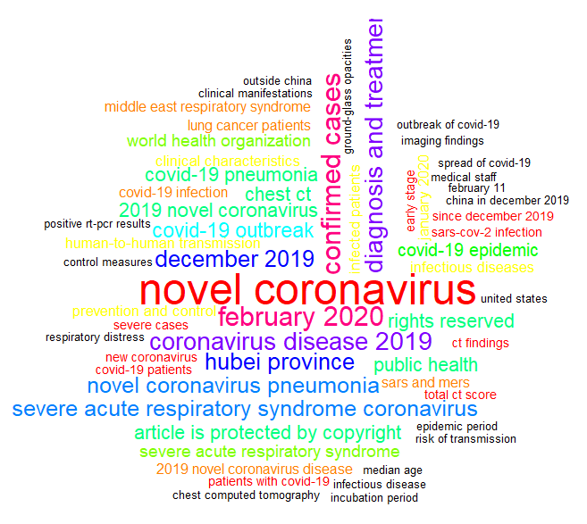
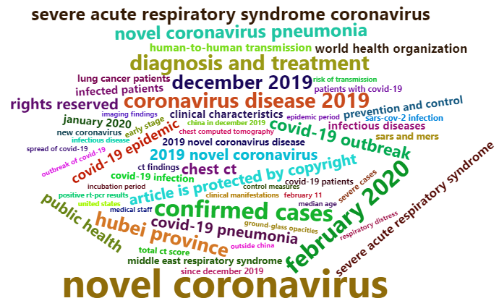
Phrase Mining in R: Example - 2
Produce a wordcloud:
sums=apply(pdm,1,sum)
set.seed(123)
myCol=c(rep("black",5),rainbow(12),rep("red",11))
wordcloud(names(sums),sums,min.freq=5,colors=myCol,random.order=F,scale=c(3,.3))
A second wordcloud:
sums2=sums[sums>=5]
wordcloud2(data.frame(word=names(sums2),freq=sums2),size=.3)
Find which documents contain certain principal phrases:
pp=c("february 11","february 2020")
getDocs(pd,pp)
Remove certain principal phrases:
pdm=as.matrix(removePhrases(pd,c("article is protected by copyright",
"rights reserved")))
docs
phrases 38 55 63 69 75 77 83 90 92 99 126 129 148 163 174 182
february 11 0 0 0 0 0 0 1 0 0 0 0 0 0 4 0 0
february 2020 1 1 2 2 1 1 0 1 1 1 1 1 1 0 1 2

Slide 11
Problem
Download from Moodle the PubMed file CovidKidsAntibodies.txt, and put it into your tmData folder. Note that we created this file in class during a previous lecture. Read it into a corpus called co. How many documents does the corpus have?
Create a phraseDoc object called pd, setting the minimum frequency to 3, and create a term-document matrix on it called pdm. How many principal phrases are there in the corpus? Show a matrix with frequencies for the first 8 principal phrases and the first 8 documents.
Find out how many documents have no principal phrases. Find their indices and inspect those documents; note that these represent unique documents that provide a different outlook from all the others.
Obtain the 5 most frequent principal phrases in the corpus and store this information in a variable called highFreq. Remove the phrases “patients with covid-19” and “covid-19 patients” from the term-document matrix. Overwrite both pd and pdm; then recreate highFreq.
Create a matrix called pdm2 with the five most frequent principal phrases in highFreq on the rows and the documents they appear in on the columns. How many such documents are there? Show the first 5 documents with their frequencies for the phrases in highFreq. Looking at these 5 documents, what is the index for the document that has the phrase “kawasaki disease”? How many times does this phrase appear in that document? Inspect that document to see if you can find the phrase(s). Find the full set of principal phrases for this document.
Create a vector called hfDocsf that contains the total frequencies over all phrases in highFreq for each document in pdm2, sorted in decreasing order.
Challenge: Create a vector called hfDocs that contains the total number of high frequency phrases (as in highFreq) by document, sorted in decreasing order. Note that we want the number of phrases, not the sum of their frequencies.
Find the index of the document with the highest number of frequencies for the high-frequency phrases (from hfDocsf). Store this index in a variable called idx. This should be an interesting document because it talks the most about the things the whole corpus talks about. So we will get some information on this document. First, show all its principal phrases. Then show its frequencies for high frequency phrases (in hfDocsf). Finally, read the abstract and find its PMID.
Create a word cloud for all principal phrases in the corpus, either one will be fine, but make sure it looks good. Set the minimum frequency appropriately.
Looking at the word cloud, we notice an interesting phrase: "cytokine storm“. For this phrase, find out in what documents it appears and inspect the document with the highest frequency for this phrase. Do the same for another interesting phrase you may choose yourself.

Slide 12
Today’s Summary
Principal phrases are phrases that are meaningful and common by itself, rather than as part of another phrase. We may obtain principal phrases for the documents in a corpus using the function phraseDoc in the phm package. This will create a phraseDoc object; use the function as.matrix on a phraseDoc object to create a term-document matrix with principal phrases. See ?phraseDoc for its arguments.
The function freqPhrases in the phm package takes a phraseDoc object and a number n as input (default 10) and shows the n most frequent phrases in the corpus.
The function getDocs in the phm package takes a phraseDoc object and a character vector with principal phrases as input and returns a term-document matrix with those principal phrases (if they exist) on the rows and the documents they appear in on the columns.
The function removePhrases in the phm package takes a phraseDoc object and a character vector with principal phrases as input and returns the phraseDoc object with those principal phrases removed.
We can use the term-document matrix with principal phrases just like the term-document matrix with words; for example, we can sum the frequencies by row then use either word cloud on those sums.

